Slide 1


Week 6
1

Slide 2
Index
2
Sr no | index
1 | Elbowpipe
2 | Tensionrod
Sr. no
1
2
3
4
5
Contents
Week1Sketch1
Week1Sketch2 Week1Assignment1
Week1Assignment2 Insights

Slide 3
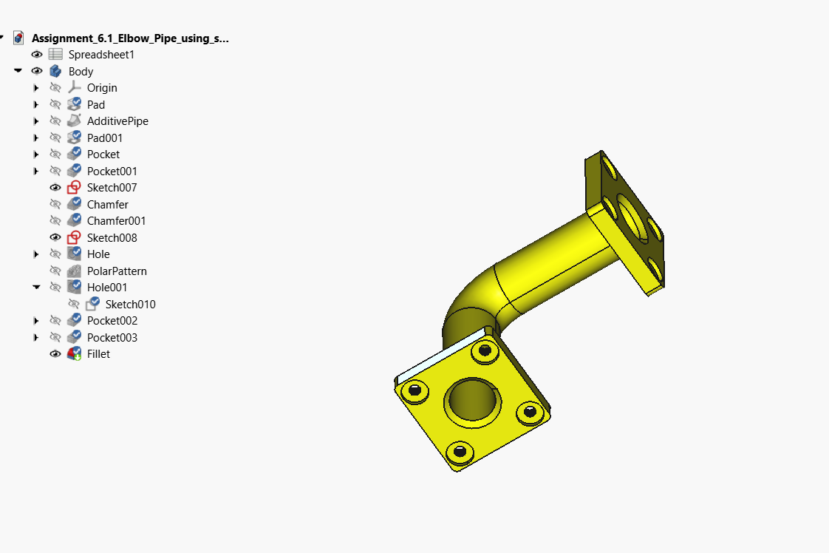
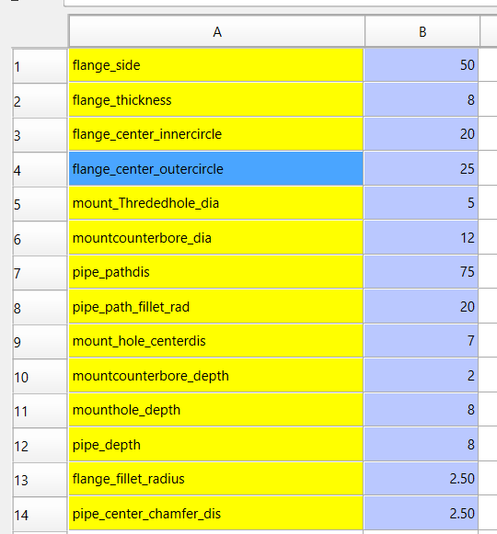
Elbow Pipe
Spreadsheet

Slide 4
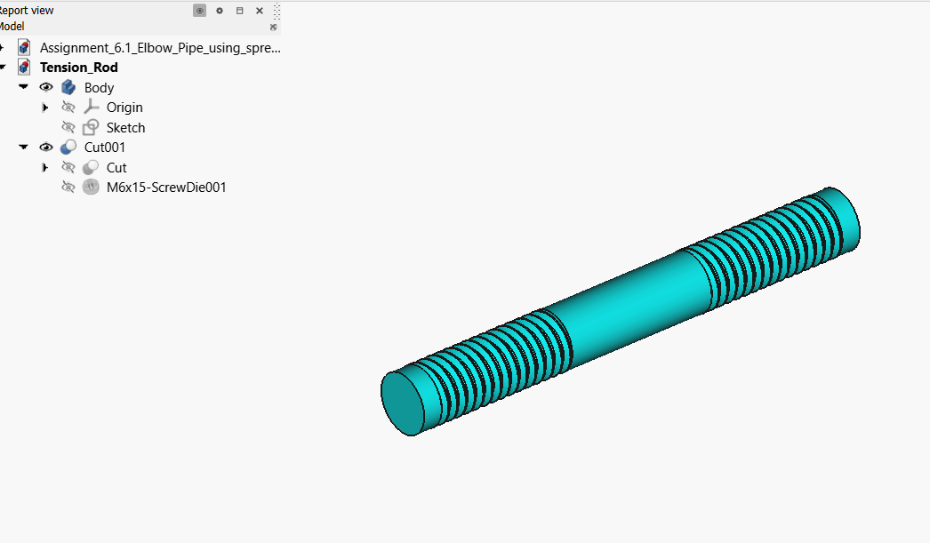
Tensionrod

Slide 5
Insights
I learned how to control dimensions of the model using a single spreadsheet.
I understood the importance of parametric design where changing one value automatically updates the entire model.
I learned how to insert standard fasteners like bolts, nuts, and washers directly into my design.I understood the significance of using standardized components for real-world manufacturing.
I learned how to combine, subtract, and intersect solid bodies using Boolean operations.

